Slide 1

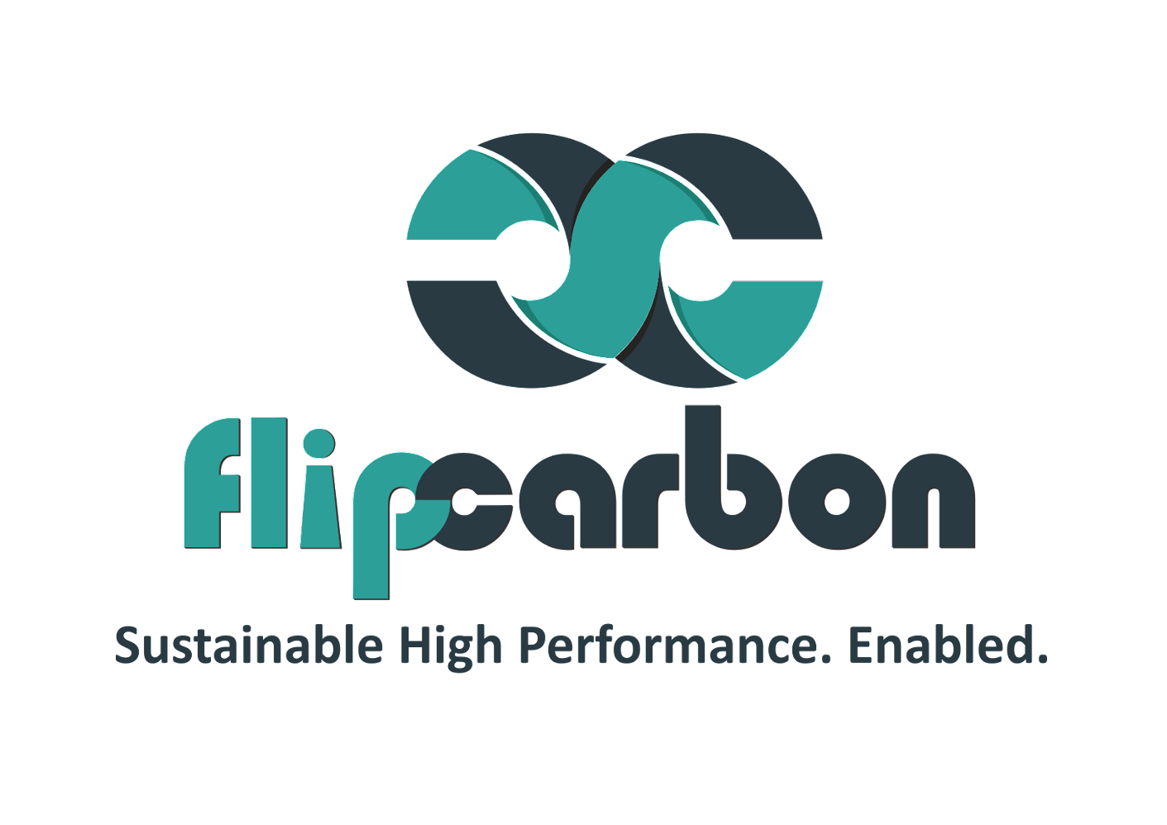
SOP – VCFO Services Pillar VII – SOPs-P2P Process Date of Publication : 25/11/23

Slide 2
Standard Process in P2P SOP Defining
Introduction
Roles and Responsibilities
Requisition process
Purchase order (PO) Creation
Supplier selection and Negotiation
Goods/Services Receipt
Invoice Verification
Three-way Match
Invoice Approval
Payment Authorization
Payment Execution
Record Keeping
Supplier Relationship Management
Training and Communication
Compliance and Auditing
Revision History
References
This is the initial framework, which can be modified by adding or removing slides according to the narration that the client wants.

Slide 3
Pitch Deck – Process Flow
Step 2: Process Analysis and Mapping
2
3
Step 3: Gap Analysis and Best Practices
1
4
Step 1: Information | Input Gathering
Step 4: Drafting the SOP
5
6
Step 5: Review and Feedback
Step 6: Finalization and Implementation
Ideally, all these process except step 6 happen parallelly for financial model assumptions as well.

Slide 4
Step 1: Information | Input Gathering
Purpose of the SOP: Clearly state the purpose of the SOP. This could be to ensure consistency, efficiency, and compliance in the P2P process.
Scope and Applicability: Define the scope of the SOP, specifying which departments or individuals it applies to. This helps avoid confusion about responsibilities

Slide 5
Step 2: Process Analysis and Mapping
Roles and Responsibilities
Define Roles: Clearly outline the roles involved in the P2P process, such as requisitioners, approvers, buyers, receivers, and accounts payable staff.
Responsibilities: Specify the responsibilities associated with each role. For example, requisitioners are responsible for accurate and complete requisitions, while approvers ensure that requests comply with policies.
Requisition Process
Initiation: Detail how requisitions are initiated. This might involve a user filling out a requisition form or using a procurement software.
Approval Workflow: Describe the workflow for obtaining approvals, including who is responsible for approvals at each level.
Documentation: Specify the required documentation for creating a purchase requisition. This could include item descriptions, quantities, and any relevant specifications.
Notes:
Establish where we gather tam, sam and som from.

Slide 6
Step 2: Process Analysis and Mapping
Purchase Order (PO) Creation
Generating POs: Explain the process for creating purchase orders based on approved requisitions.
Information in POs: List the essential information that must be included in a PO, such as item details, quantities, prices, and terms.
Approval Process: Define the approval process for purchase orders, including any thresholds for different levels of approval.
Supplier Selection and Negotiation
Criteria for Selection: Outline the criteria used to select suppliers, such as cost, quality, and reliability.
Negotiation Procedures: Describe how negotiations with suppliers are conducted, covering aspects like pricing, delivery schedules, and payment terms.
Documentation: Specify the documentation required to record negotiated terms and agreements.
Notes:
Establish where we gather tam, sam and som from.

Slide 7
Step 3: Gap Analysis and Best Practices
Goods/Services Receipt
Acknowledging Receipt: Explain how the receiving department acknowledges the receipt of goods or services.
Inspection Procedures: If applicable, detail the procedures for physically inspecting goods to ensure they meet specifications.
Documentation: Clarify the documentation requirements for confirming the receipt of goods or services.
Invoice Verification
Verifying Invoices: Describe the process for verifying supplier invoices against corresponding purchase orders.
Handling Discrepancies: Provide procedures for handling discrepancies and resolving issues between the PO, goods receipt, and invoice.
Documentation: Specify the documentation requirements for the verification process.

Slide 8
Step 3: Gap Analysis and Best Practices
Three-Way Match
Explanation: Provide a more detailed explanation of the three-way match process, emphasizing the importance of reconciling the PO, goods receipt, and invoice.
Discrepancy Resolution: Detail the steps for resolving discrepancies found during the three-way match.
Documentation: Highlight the documentation needed to support the three-way match.
Invoice Approval
Approval Workflow: Define the workflow for approving supplier invoices, specifying who is responsible for approvals.
Criteria for Approval: Outline the criteria for approving invoices, ensuring compliance with established policies.
Documentation: Clarify the documentation requirements for invoice approval.

Slide 9
Step 4: Drafting the SOP
Payment Authorization
Authorization Process: Explain the process for authorizing payments after invoices have been approved.
Adherence to Payment Terms: Emphasize the importance of adhering to negotiated payment terms and any legal or contractual obligations.
Documentation: Specify the documentation requirements for authorizing payments.
Payment Execution
Processing Payments: Detail the procedures for processing payments, including the chosen payment methods (e.g., checks, electronic funds transfer).
Record-Keeping: Outline how records of completed payments are kept and maintained.
Communication with Suppliers: Describe the communication process with suppliers regarding payment status.

Slide 10
Step 4: Drafting the SOP
Record Keeping
Requirements: Clearly state the requirements for maintaining records related to P2P transactions.
Duration of Record Retention: Specify how long records should be retained and the procedures for secure storage and disposal.
Accessibility: Define who has access to these records and under what circumstances.
Supplier Relationship Management
Communication Guidelines: Provide guidelines for ongoing communication with suppliers to foster positive relationships.
Issue Resolution: Detail processes for addressing supplier issues and disputes.
Continuous Improvement: Encourage ongoing evaluation and improvement of supplier

Slide 11
Step 5: Review and Feedback
Training and Communication
Training Programs: Outline any training programs for individuals involved in the P2P process.
Communication Channels: Specify the channels for communicating updates and changes to the P2P SOP.
Compliance and Auditing
Compliance Measures: Detail measures in place to ensure compliance with relevant policies, regulations, and legal requirements.
Audit Procedures: Outline procedures for internal and external audits of the P2P process, including frequency and reporting.

Slide 12
Step 6: Finalization and Implementation
16. Revision History
Record of Changes: Maintain a clear record of changes made to the SOP, including dates and reasons for revisions.
17. References
Citations: Include references to relevant policies, regulations, or external guidelines that the SOP is based on.

